Slide 1
Understanding Preferences
The effects of personality in the workplace

Slide 2
Objective
Given a description of the Myers-Briggs theory, the learners will determine their own MBTI preference using the best fit of:
  type characteristics
  work situation effects
  communication preferences
  key words
  MBTI questionnaire results

Slide 3
Psychological Type
Researchers have been concerned with the effects of human differences in the workplace
We will discuss a theory developed by Carl Jung (1875-1961)
  explains how different people react differently to the same stimulus
  explains how patterns of normal behaviour develop
  differences caused by how people prefer to use their minds

Slide 4
Benefits of Using Types
Offers a logical model of consistent behaviour
Reduces interpersonal and organizational conflict
Shows the value of diversity
Highlights strengths and blind spots of individuals and teams
Clarifies the fit between people and jobs
Guided by ethical principles

Slide 5
Benefits of Type to Individuals
Provides a path to self-understanding
Gives an objective framework for examining emotional issues
Helps improve communication patterns
Helps identify sources of conflict
Aids people in valuing their unique contributions
Improves motivation and commitment

Slide 6
Benefits of Type to Teams
Reduces unproductive work by improving communication
Clarifies team behaviour and dynamics
Helps match task activities to specific personality types
Provides an objective framework for dealing with conflict
Helps individuals understand how different perspectives and methods work together

Slide 7
Primary Mental Activities
When your mind is active, you use one of two mental activities:
  taking in information, called Perceiving
  organizing that information and coming to conclusions, called Judging
Two ways of perceiving:
  Sensing and Intuition
Two ways of judging:
  Thinking and Feeling

Slide 8
Focus of Attention
People use the four functions in both the external world and in the internal world
  Sensing
  Intuition
  Thinking
  Feeling
Using these in the external world is Extraversion, in the internal world is Introversion

Slide 9
Why are People Different?
Jung believed everyone has a natural preference for using one kind of Perceiving and one kind of Judging
He also observed that people are drawn more to the external world or to the internal world
As people exercise these preferences, distinct perspectives and approaches develop to life and human interaction
These lead to fundamental differences

Slide 10
Illustrating Preferences
A simple exercise illustrates what Jung meant by “preferences”
Take a sheet of paper
First sign your name as you normally do
Then sign your name again, but use your other hand
Describe the experience

Slide 11
Typical Experiences
Preferred hand
  feels natural
  didn’t think about it, just did it
  effortless, easy
  looks neat, legible, adult
Non-preferred hand
  feels unnatural
  had to think, concentrate, while doing it
  required energy
  awkward and clumsy
Most people can sign with either hand, but the preferred one is natural and competent, where the other feels awkward

Slide 12
Measuring Type
Katharine Cook Briggs (1875-1968) and Isabel Briggs Myers (1897-1980) studied Jung and developed an indicator to help individuals to know their psychological type
The Myers-Briggs Type Indicator (MBTI)* is a self-report questionnaire based on Jung’s theory
We will use the MBTI model in this class for our understanding of psychological types
* Myers-Briggs Type Indicator and MBTI are registered trademarks of Consulting Psychologists Press, Inc.

Slide 13
References
Gifts Differing by Isabel Briggs Myers, 1980
Introduction to Type by Isabel Briggs Myers, Fifth Edition (1993)
Introduction to Type in Organizations, by S. K. Hirsh and J. M. Kummerow, Second Edition (1990)
Using the Myers-Briggs Type Indicator in Organizations, by S. K. Hirsh, Second Edition (1991)
MBTI Team Building Program by S. K. Hirsh, (1992)

Slide 14
Four Preference Scales
Extraversion or Introversion
  E 45.9/52.5% I 54.1/47.5%
Sensing or Intuition
  S 71.7/74.9% N 28.3/25.1%
Thinking or Feeling
  T 56.5/24.5% F 43.5/75.5%
Judging or Perceiving
  J 52.0/56.2% P 48.0/43.8%
Notes:
Estimated percentage in US population, from National Representative Sample, male/female percentage. source: MBTI Manual, 1998

Slide 15
Evaluating Your Type
The next several slides have two purposes
  understanding differences due to type
  deciding what your own type preferences are
As we go through the slides, check off the items that apply to you
At the end of each section, evaluate your preference, and choose which of the alternatives you like better
This gives your initial self-assessment

Slide 16
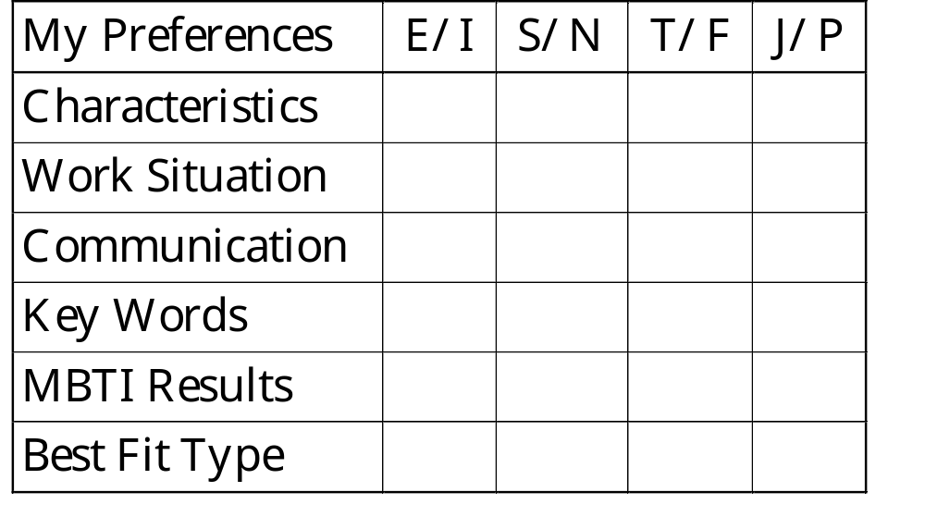
MBTI Best Fit Worksheet

Slide 17
Extraversion or Introversion
Complementary attitudes toward the world
People who prefer Extraversion (E)
  focus on the outer world of people and external events
  direct their energy and attention outward and receive energy from external events, experiences and interactions
People who prefer Introversion (I)
  focus on their own inner world of ideas and experiences
  direct their energy and attention inward and receive energy from their inner thoughts, feelings and reflections
Both Attitudes used by everyone, but one is usually preferred and better developed

Slide 18
Characteristics of EI
Prefer Extraversion
  attuned to external environment
  prefer to communicate by talking
  learn through doing or discussing
  breadth of interests
  speak first, reflect later
  sociable and expressive
  take initiative in work and relationships
Prefer Introversion
  drawn to their inner worlds
  prefer to communicate by writing
  learn through reflection, mental “practice”
  depth of interest
  reflect first, act later
  private and contained
  focus readily

Slide 19
EI in Work Situation
Prefer Extraversion
  like variety and action
  impatient with long, slow jobs
  interested in activities and how others do it
  act quickly, maybe without thinking
  ideas by discussion
  like people around
  learn by talking and doing
Prefer Introversion
  like quiet for concentration
  don’t mind working on one project for a long time
  interested in facts/ideas behind their work
  think a lot before they act, sometimes don’t act
  ideas by reflection
  like working alone
  learn by reading and reflecting

Slide 20
EI Methods of Communication
Prefer Extraversion
  communicate energy and enthusiasm
  respond quickly without long pauses to think
  focus on people/things
  need to moderate expression
  communicate in groups
  prefer face-to-face
  talk out loud before coming to conclusions
Prefer Introversion
  keep energy and enthusiasm inside
  like to think before responding
  focus on ideas/thoughts
  need to be drawn out, increase expression
  communicate one-to-one
  prefer written
  verbalize already well thought out conclusions

Slide 21
EI Key Words
Prefer Extraversion
  active
  outward
  sociable
  people
  many
  expressive
  breadth
  interaction
  do-think-do
Prefer Introversion
  reflective
  inward
  reserved
  privacy
  few
  quiet
  depth
  concentration
  think-do-think

Slide 22
Sensing or Intuition
Ways of taking in information
People who prefer Sensing (S)
  like to take in information via eyes, ears, and other senses to find out what is actually happening
  are observant if what is going on, recognizing practical realities of the situation
People who prefer Intuition (N)
  like to take in information by seeing the big picture, focusing on the relationship and connections between facts
  want to grasp patterns and see new possibilities/different ways of doing things
Both ways of perceiving are used by everyone, but one is usually preferred and better developed

Slide 23
Characteristics of SN
Prefer Sensing
  focus on real and actual
  value practical applications
  factual and concrete, notice details
  observe and remember sequentially
  present-oriented
  want information step-by-step
  trust experience
Prefer Intuition
  focus on “big-picture”
  value imaginative insights
  abstract and theoretical, bored with details
  see patterns and meanings in facts
  future-oriented
  jump around, leap in anywhere
  trust inspiration

Slide 24
SN in Work Situation
Prefer Sensing
  experience and standard ways to solve problems
  enjoy applying what they have already learned
  may distrust and ignore their inspirations
  few errors of fact
  things with practical bent
  show details of work first
  prefer continuation of what is, with fine tuning
  proceed step-by-step
Prefer Intuition
  like solving new complex problems
  enjoy learning a new skill more than using it
  will follow their inspirations
  may overlook facts
  with innovative bent
  show overview first
  prefer change, maybe radical, to continuation
  in bursts of energy

Slide 25
SN Methods of Communication
Prefer Sensing
  evidence (facts, details, examples) presented first
  practical and realistic applications shown
  direct experience to provide anecdotes
  orderly step-by-step
  like straightforward and feasible
  refer to specific example
  follow the agenda
Prefer Intuition
  global schemes, broad issues presented first
  possible future challenges discussed
  insights/imagination to provoke discussion
  round-about approach
  like the novel and unusual
  refer to general concept
  agenda is starting point

Slide 26
SN Key Words
Prefer Sensing
  details
  present
  practical
  facts
  sequential
  directions
  repetition
  enjoyment
  perspiration
  conserve
Prefer Intuition
  patterns
  future
  imaginative
  innovations
  random
  hunches
  variety
  anticipation
  inspiration
  change

Slide 27
Thinking or Feeling
Are ways of making decisions
People who prefer Thinking
  look at the logical consequences of a choice or action
  seek an objective standard of truth and the application of principles
People who prefer Feeling
  consider what is important to them and other people
  seek harmony and recognition of individuals
Both ways of deciding/evaluating used by everyone, but one is usually preferred and better developed

Slide 28
Characteristics of TF
Prefer Thinking
  analytical
  logical problem-solvers
  use cause-and-effect reasoning
  “tough-minded”
  strive for impersonal, objective truth
  reasonable
  fair
Prefer Feeling
  sympathetic
  assess impact on people
  guided by personal values
  “tender-hearted”
  strive for harmony and individual validation
  compassionate
  accepting

Slide 29
TF in Work Situation
Prefer Thinking
  use logical analysis
  want mutual respect
  may hurt feelings without knowing it
  decide impersonally, ignore people’s wishes
  firm-minded, can give criticism
  look at principles involved in situation
  like job done well
Prefer Feeling
  use values
  want harmony / support
  enjoy pleasing, even in unimportant things
  decisions influenced by own and others wishes
  sympathetic, dislike saying unpleasant things
  look at underlying values in situation
  like people’s needs met

Slide 30
TF Methods of Communication
Prefer Thinking
  brief and concise
  want pros and cons of each alternative
  intellectually critical and objective
  convinced by cool, impersonal reasoning
  goals and objectives first
  consider emotions and feelings as data to weigh
  involvement with tasks
Prefer Feeling
  sociable and friendly
  want why alternative is valuable and affects us
  interpersonally appreciative
  convinced by personal, enthusiastic information
  points of agreement first
  consider logic and objectivity as data to value
  involvement with people

Slide 31
TF Key Words
Prefer Thinking
  head
  logical system
  objective
  justice
  cool
  impersonal
  critique
  analyze
  precise
  principles
Prefer Feeling
  heart
  value system
  subjective
  harmony
  caring
  personal
  appreciate
  empathize
  persuasive
  values

Slide 32
Judging or Perceiving
Orientation toward the outer world
People who prefer to use their Judging process
  tend to live in a planned, orderly way, wanting to regulate and control life
  sticking to a plan and schedule is very important to them
People who prefer to use their Perceiving process
  tend to live in a flexible, spontaneous way, seeking to experience and understand life
  trust their resourcefulness and ability to adapt to situation
Both attitudes used by everyone, but one is usually preferred and better developed

Slide 33
Characteristics of JP
Prefer to use Judging
  scheduled
  organized
  systematic
  methodical
  plan
  like closure -- to have things decided
  avoid last-minute stresses
Prefer to use Perceiving
  spontaneous
  open-ended
  casual
  flexible
  adapt
  like things loose and open to change
  feel energized by last-minute pressures

Slide 34
JP in Work Situation
Prefer to use Judging
  plan their work and follow their plan
  get things settled and finished
  overlook new things needing to be done
  satisfied once decision reached
  decides quickly
  supported by structure
  focus on completion
Prefer to use Perceiving
  enjoy flexibility in their work
  leave things open for last-minute changes
  postpone unpleasant tasks needing to be done
  welcome new information
  searches for options
  restricted without variety
  focus on process

Slide 35
JP Methods of Communication
Prefer to use Judging
  want schedules with tight deadlines
  dislike surprises
  expect others to follow through, count on it
  state positions and decisions clearly
  communicate results and achievements
  purpose and direction
  focus on task to be done
Prefer to use Perceiving
  uncomfortable with tight deadlines
  enjoy surprises
  expect others to adapt to situational requirements
  present views as tentative and modifiable
  communicate options and opportunities
  autonomy and flexibility
  on process to be needed

Slide 36
JP Key Words
Prefer to use Judging
  organized
  regulate
  control
  decisive
  deliberate
  closure
  plan
  deadlines
  productive
  settled
Prefer to use Perceiving
  flexible
  flow
  adapt
  curious
  spontaneous
  openness
  wait
  discoveries
  receptive
  tentative

Slide 37
Combination of Preferences
Taking all four preferences together
  Extraversion (E) or Introversion (I)
  Sensing (S) or Intuition (N)
  Thinking (T) or Feeling (F)
  Judging (J) or Perceiving (P)
Gives your psychological type
But remember
  everyone is an individual!

Slide 38
Understanding the MBTI Report
The MBTI report gives your reported type and preference scores
The preference scores show how clearly you indicated a preference
  very clear preferences: 41 up (31 up for feeling)
  clear preferences: 21-39 (21-29 for feeling)
  moderate preferences: 11-19
  slight preferences: 1-9
Low scores often represent tension between the two poles, or social pressure

Slide 39
Validating Your Type Preference
Your self-evaluations and the MBTI report are indications of your type preference
The back of the report form contains a thumb nail description of the characteristics often associated with each type
If the indications agree and the characteristics feel comfortable, then you have likely identified your preferences
You are the final arbiter

Slide 40
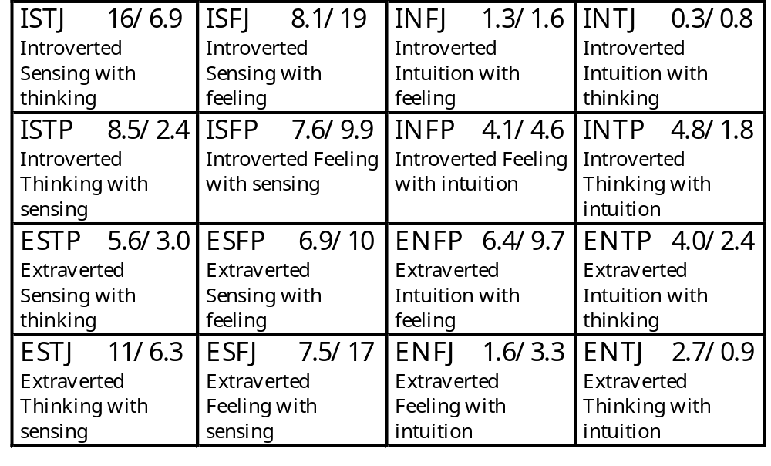
Putting it Together
Sixteen types
Notes:
Estimated frequencies in US population, in percentage to 2 figures.
male/female national representative sample, n=1478 males, n=1531 females. Source: MBTI Manual, 1998

Slide 41
Type Dynamics
The four preferences indicate our choices from eight possibilities
The middle two preferences (SN and TF) are called functions
Type dynamics indicates the usual order of development of the four functions
Usually the more preferred are used more often and are better developed

Slide 42
Objective
When asked by the instructor, the learner will explain type development dynamics, including:
  typical development over a lifetime
  effects of dominant, auxiliary and inferior functions
List the dominant, auxiliary and inferior function for each type

Slide 43
Dominant Function
The most preferred function is called the dominant function
The dominant function takes the lead in shaping the personality
People use the dominant function most in their favourite world
  extraverts use dominant more in external world
  introverts use dominant more in internal world
    this makes the dominant of introverts harder to see

Slide 44
Example: Find the Dominant
ESTP
ESTJ
ENFP
ENFJ
ISTP
ISTJ
INFP
INFJ
ENTP
ENTJ
ESFP
ESFJ
INTP
INTJ
ISFP
ISFJ
Note that JP indicates whether judging or perceiving is preferred in dealing with the external world

Slide 45
Strengths of Dominant
When Sensing is dominant you are likely to
  recognize the pertinent facts
  apply experience to problems
  notice what needs attention
  keep track of essentials
  handle problems with realism

Slide 46
Strengths of Dominant
When Intuition is dominant you are likely to
  recognize new possibilities
  supply ingenuity to problems
  see how to prepare for the future
  watch for new essentials
  tackle new problems with zest

Slide 47
Strengths of Dominant
When Thinking is dominant you are likely to
  be good at analysis
  find flaws in advance
  hold consistently to a policy
  weigh the law and the evidence
  stand firm against opposition

Slide 48
Strengths of Dominant
When Feeling is dominant you are likely to
  be good at empathizing
  forecast how others will feel
  allow for extenuating circumstances
  be aware of values
  appreciate each person’s contributions

Slide 49
How to Work with Dominants
Sensing Dominants:
  it has to make sense - Stability
  point out pertinent facts
  use their past experience
  notice what needs attention
  have the right thing in the right place at the right time; keep the essentials on hand
  adopt realistic schedules and time frames

Slide 50
How to Work with Dominants
Intuitive Dominants:
  it has to appeal to the imagination - Change
  recognize new avenues and possibilities
  develop ingenious insights
  predict future outcomes
  conjure up plans for future contingencies
  supply enthusiasm, zest, and a spirit of optimism

Slide 51
How to Work with Dominants
Thinking Dominants:
  it has to be logical - Effective
  analyze a situation’s or person’s strengths and weaknesses
  “save the day” by pointing out flaws in advance
  stay with the goal and be consistent, moving from past to present to future
  keep a steady course in the face of opposition
  be objective, straight-forward, brief, and concise

Slide 52
How to Work with Dominants
Feeling Dominants:
  it has to consider people’s aspirations - Integrity
  ask about people’s concerns and empathize with them
  anticipate the needs of others and how they feel
  make exceptions due to external circumstances
  monitor and hold the organization and team to its values
  appreciate, encourage, nourish, and support each person

Slide 53
Auxiliary Function
The other function in the type code is called the auxiliary function (other of middle letters)
Everyone needs both information and decision-making
If dominant is an information-gathering function (SN), then auxiliary will be a deciding function (TF) and vice versa
Auxiliary is more often used in less favoured world

Slide 54
Example: Find the Auxiliary
ESTP
ESTJ
ENFP
ENFJ
ISTP
ISTJ
INFP
INFJ
ENTP
ENTJ
ESFP
ESFJ
INTP
INTJ
ISFP
ISFJ
Note that JP indicates whether judging or perceiving is preferred in dealing with the external world

Slide 55
Note on Introverts
Introverts are more likely to show auxiliary to others because their dominant function is used mainly inside in their favoured introverted world
This means that introverts interact using their second best
Sometimes this leads introverts to be underrated

Slide 56
Tertiary and Inferior Functions
The two functions that are not in the type code are also used, just less often
The opposite of the auxiliary is the third, or tertiary, function
The opposite of the dominant is the fourth, or inferior, function
The inferior shows itself when under stress, or not acting like yourself

Slide 57
Example: Find the Inferior
ESTP
ESTJ
ENFP
ENFJ
ISTP
ISTJ
INFP
INFJ
ENTP
ENTJ
ESFP
ESFJ
INTP
INTJ
ISFP
ISFJ
Note that JP indicates whether judging or perceiving is preferred in dealing with the external world

Slide 58
Note on Development
Usually the dominant function is developed first in children
Auxiliary is developed later and is not as mature
Tertiary is developed much later, and is much less mature
Inferior is usually poorly developed and quite childish
  inferior often source of inspirational experiences

Slide 59
Accepting Differences
Often people thing everyone should be like themselves
When we encounter someone different, we may have a bias against them
Type differences are a part of this
We have to be on guard against type biases

Slide 60
Objective
Given a person whose type is different from the learner’s, the learner will show acceptance for the person by
  identifying applicable type biases
  expressing the nonbiased reality
  showing the contribution the other’s type makes in a group situation

Slide 61
Type Biases
E’s may think I’s are withholding information when they are processing internally
I’s may think E’s are changing their minds when they are processing a decision verbally
S’s may think N’s are changing the subject when they are generating possibilities
N’s may think S’s are unimaginative when they are being realistic about practical things

Slide 62
Type Biases
T’s may think F’s are over-personalizing when they focus on impacts on individuals
F’s may think T’s are harsh and cold when they take a detached problem-solving view
J’s may think P’s are lazy or procrastinating when they are trying to keep options open
P’s may think J’s are rigid and controlling when they are structuring and scheduling

Slide 63
MBTI Lenses
Grouping of 16 types can highlight behaviours important in different situations
Dynamic Lens: dominant S, N, T, F
  problem-solving or decision-making style
Quadrant Lens: IS, IN, ES, EN
  change or cultural issues
Function Lens: columns ST, SF, NF, NT
  communications issues
Temperament Lens: SJ, SP, NF, NT
  leadership issues
Notes:
Ask which ones are most important to them, cover these

Slide 64
Type and Problem Solving
Your preferred type effects your preferred problem solving method
Best problem solving involves using all four functions
  critical for important decisions

Slide 65
Objective
Given a type preference, the learner will analyze the effects of that type on problem solving by
  correctly identifying the dominant function
  characterizing the effect of that function on problem solving
Describe the four function problem solving model

Slide 66
Dominants and Problem Solving
Sensing Dominants:
  how is the problem best defined?
  what are the ramifications now?
  what goals are we working towards?
  how can time lines be established and what are the immediate objectives?
  what costs are incurred -- financial, emotional, etc.?

Slide 67
Dominants and Problem Solving
Intuitive Dominants:
  what are the common threads?
  what are the multiple alternatives?
  what is the relationship of the part to the system?
  what are the opportunities for growth?
  what are our hunches about this issue?

Slide 68
Dominants and Problem Solving
Thinking Dominants:
  is this a legitimate issue?
  how does it affect the bottom line?
  what are the pros and cons?
  what is the relationship of cause to effect?
  what are the systemic qualities?

Slide 69
Dominants and Problem Solving
Feeling Dominants:
  what are people’s feelings concerning this?
  how can different sides be accommodated?
  what’s the most diplomatic way to proceed?
  what will increase harmony?
  how does this affect me and the people I care about?

Slide 70
Problem Solving Model
Define the problem - sensing
Consider all the possibilities - intuition
Weigh the consequences - thinking
Weigh the people impact- feeling
Make the final decision
Do it!
Evaluate the decision
Notes:
See Introduction to Type, p 29

Slide 71
Dealing with Change
Type preferences have a major impact on how people deal with change
Most of the differences are determined by quadrant
  IS, IN, ES, EN

Slide 72
Objective
Given a type preference, the learner will analyze the effects of that type in dealing with changes
  correctly identify the type’s quadrant
  characterize how people of that quadrant deal with changes

Slide 73
Dealing with Change
The four quadrants, IS, IN, ES, EN seem to group people together who react similarly to change
This is useful for reorganization issues, organizational or team culture, or relationships with customers
E/I relate to preferred organizational work setting
S/N relate to how we view the world

Slide 74
Introducing Change to Quadrants
Ways to introduce change to an IS
  relate it to what I know
  make practical sense to me
  change at a steady pace, step by step
  be careful and mindful of details
  give me time to think about it
  change “the way things are done around here” only from necessity

Slide 75
Introducing Change to Quadrants
Ways to introduce change to an IN
  relate it to new theories and concepts
  let me work on change that has impact, especially conceptually and with ideas
  don’t burden me with routines; let me change at my own pace, swiftly or slowly, as I think I need to
  let me set my own quality control and standards
  let me work with my own ideas
  change the ideas and concepts

Slide 76
Introducing Change to Quadrants
Ways to introduce change to an ES
  relate it to the work I do
  show me the practical results change will bring
  offer a steady progression, step by step
  be realistic with the schedule and don’t expect too much too soon
  let me “hash it over” with others
  show me that my work will be more effective if I make the change

Slide 77
Introducing Change to Quadrants
Ways to introduce change to an EN
  relate it to changing things in my world
  challenge my imagination
  minimize the routine; maximize the variety
  let me work on the broad focus and overview of the change
  let me brainstorm with others and try out my ideas to see if they work and how people react to them
  let me try to change the world

Slide 78
Communications Styles
Preferred functions (ST, SF, NF, NT) most important here
  ST practical and logical
  SF sympathetic and friendly
  NF enthusiastic and insightful
  NT logical and ingenious
Impacts teamwork, team tasks

Slide 79
Objective
Given a type preference, the learner will analyze the effects of that type on communications preferences by
  correctly identifying the function column of the type
  characterizing the way people of that column prefer to communicate

Slide 80
How to Persuade STs
Show me that it works
Indicate how it saves time and money
Demonstrate a good cost-to-benefit ratio
Show how the results can be measured
Allow me to try it before I buy it
Offer specific applications and benefits
Answer all my questions
from Sandra Krebs Hirsh © 1992 by Consulting Psychologists Press, Inc.

Slide 81
How to Persuade SFs
Indicate its practical results for people
Show how it will clearly benefit me and those I care about
Use personal testimonies from those who have benefited from it
Show that it provides immediate results
Set it in a personal context
Show respect to me and others in your presentation
Explicitly state the benefits; don’t just imply them
from Sandra Krebs Hirsh © 1992 by Consulting Psychologists Press, Inc.

Slide 82
How to Persuade NFs
How how it will enhance relationships
State how it helps people grow and develop
Focus on my own and other’s giftedness
Show how it gives new insights and perspectives
Indicate that people will like it, and, by implication, will like me
Point out how it will help me find meaning
Say it’s enjoyable and fun
from Sandra Krebs Hirsh © 1992 by Consulting Psychologists Press, Inc.

Slide 83
How to Persuade NTs
Discuss its research base
Highlight its theoretical background
Demonstrate how it fits a strategy
Show how it will increase competency
Indicate its broad and far-reaching possibilities
Be a credible source of information
from Sandra Krebs Hirsh © 1992 by Consulting Psychologists Press, Inc.

Slide 84
Leadership Styles
The temperament lens correlates with styles of leadership
Temperament was independently researched by Keirsey and Bates
  originally published as a simple type model
  four choices
Similar to “True Colors”

Slide 85
Objective
Given a type preference, the learner will analyze the effects of that preference on leadership
  correctly identify the temperament
  characterize the associated leadership style

Slide 86
Four Temperaments
Due to Keirsey and Bates
Named from four Greek gods tasked with making man more like the gods
  Apollo to give man a sense of spirit
  Prometheus to give man science
  Dionysus to teach man joy
  Epimetheus to convey a sense of duty
Highlights leadership issues

Slide 87
Four Temperaments
SN choice is most important
  Controls how we view the world
Intuitives opt for either Apollonean spirituality or Promethean science
  NF : Apollonean
  NT: Promethean
Sensors opt for either Epimethean duty or Dionysian joy
  SJ: Epimethean
  SP: Dionysian

Slide 88
Apollonean NF (Sensitive)
13.5/19.2% of US population
Catalyst, spokesperson, energizer
  works by interacting with people about values and inspirations
A phenomenal capacity for working with people and drawing out their best
Articulate and persuasive
Strong desire to help others
Need: authenticity
"To thine own self be true"

Slide 89
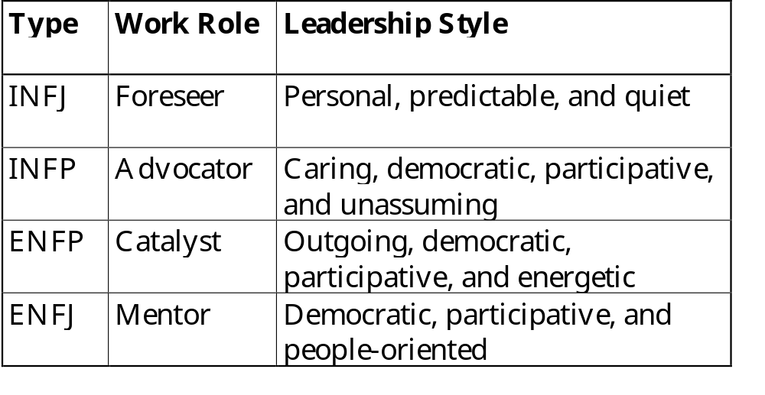
NF Work Role and
Leadership Style
from Sandra Krebs Hirsh © 1992 by Consulting Psychologists Press, Inc.

Slide 90
Promethean NT (Cool)
14.8/5.9% of US population
Visionary, architect of systems, builder
  works on ideas with ingenuity and logic
Ability to readily see big picture
Talent for conceptualization and systems planning
Insight into internal logic and underlying principles
Need: competence
"Be excellent in all things"

Slide 91
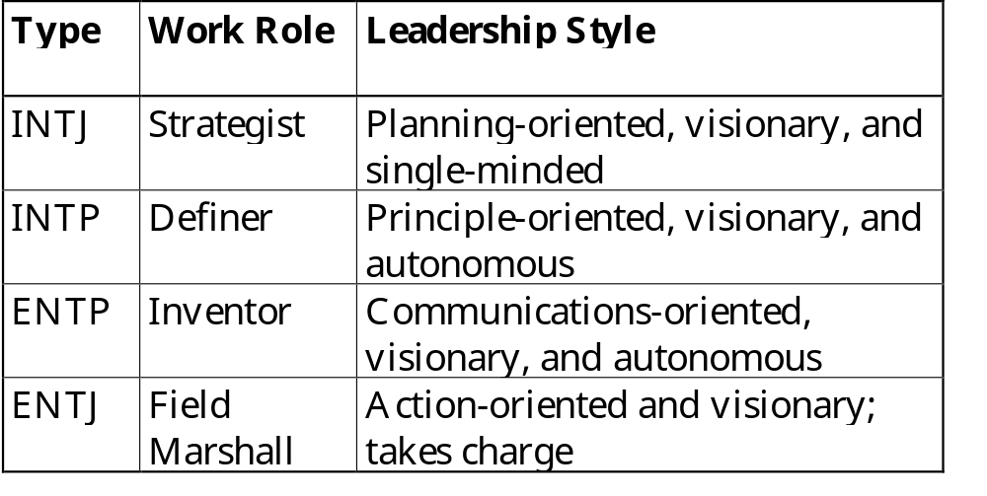
NT Work Role and
Leadership Style
from Sandra Krebs Hirsh © 1992 by Consulting Psychologists Press, Inc.

Slide 92
Epimethean SJ (Serious)
43.1/49.5% of US population
Traditionalist, stabilizer, consolidator
  works from a sense of responsibility, loyalty, and industry
Administrators
Dependable
Able to take charge
Need: belonging
"Early to bed, early to rise"

Slide 93
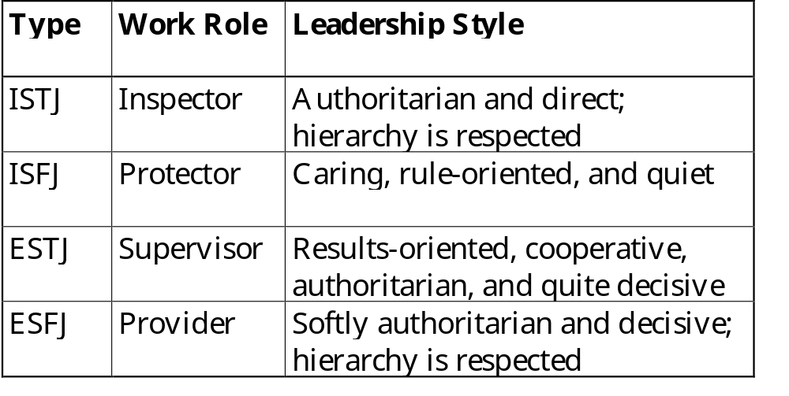
SJ Work Role and
Leadership Style
from Sandra Krebs Hirsh © 1992 by Consulting Psychologists Press, Inc.

Slide 94
Dionysian SP (Impulsive)
28.6/25.3% of US population
Troubleshooter, negotiator, fire fighter
  works via action with cleverness and timeliness
Hedonistic, live-for-now nature
Practical
Adept problem solving skills
Need: freedom
"Eat, drink, and be merry"

Slide 95
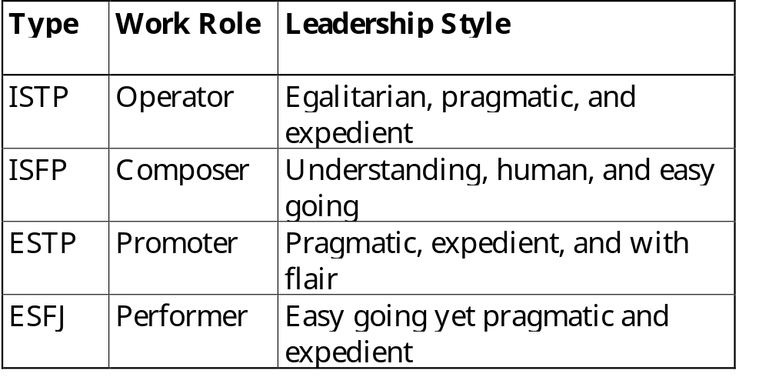
SP Work Role and
Leadership Style
from Sandra Krebs Hirsh © 1992 by Consulting Psychologists Press, Inc.

Slide 96
Team Issues
Groups have similar behaviour issues as people do
Team type determined by number of team members who are E vs I, S vs N, T vs F, J vs P
Team type can highlight team strengths, weaknesses, and performance issues
  increase personal and interpersonal effectiveness
Notes:
Need to expand this one!!

Slide 97
Assessing Type: J-P
Usually the most obvious
Judgers tend to be more focused on a task or topic
Judgers have built in time clock
Perceivers are capable of generating alternatives to any situation
Judgers tend to offer decisive opinions on most topics
Perceivers often answer a question with another question
Notes:
Tricky bit is that we tend to see behavior at work which may involve compensations to preferences. Type more apparent in a relaxed situation.
Should always be a tentative evaluation, subject to change with more information.

Slide 98
Assessing Type: E-I
Usually clear over time
Extraverts speak more loudly than Introverts
Extraverts tend to speak more rapidly
Introverts tend to understate points
Extraverts use more nonverbal communication
Introverts often appear more aloof and reserved
Cats and Dogs

Slide 99
Assessing Type: S-N
Tougher to see
Intuitives tend to look for the meaning of an event or experience; Sensors tend to examine its components
Sensors like to understand a process by looking at it sequentially; Intuitives randomly gather information and fit it into a model
Sensors focus on "what is" and find "what can be" unsettling; Intuitives find "what is" depressing
Sensors are impatient with fanciful schemes; Intuitives are impatient with many details

Slide 100
Assessing Type: T-F
Can be hardest to see
Thinkers seek objective clarity; Feelers seek harmony with people
Feelers are usually situational and subjective; Thinkers tend to apply their decisions more uniformly and consistently
Thinkers look for the cause and effect of a decision; Feelers show more concern for how people will feel about it
Both have feelings: Feelers prefer to experience them while Thinkers prefer to understand them
Notes:
Difficult to tell at a given moment whether an opinion is objective or subjective.
In general, Feelers are pleasers.

Slide 101
More Type Information
Life Types by Sandra Hirsh & Jean Kummerow, 1989
The Character of Organizations by William Bridges, 1992
Type Talk by Otto Kroeger and Janet Thuesen, 1988
Manual: A Guide to the Development and Use of the Myers-Briggs Type Indicator by Isabel Briggs Myers and Mary McCaulley, 1985
Please Understand Me by David Keirsey and Marilyn Bates, 1984

